Slide 1
Big Data Hadoop and Spark Real Time
Project – Marketing Analysis
Ishan Gandhi
ishan2303@gmail.com
20th Feb 2017

Slide 2
Analyze marketing data for call campaign by bank
A Portuguese banking institution has ran a marketing campaign to convince potential customers to invest in bank term deposit.
The customers were contacted on phone, in order to assess if they would want to subscribe to the bank term deposit or not.
The marketing team has asked to analyze the data collected through the marketing campaign and come with some meaning full insights.

Slide 3
Project Goal requirements R(1-9)
Load data and create Spark data frame.
Give marketing success rate. (No. of people subscribed / total no. of entries).
Give marketing failure rate.
Maximum, Mean, and Minimum age of average targeted customer
Check quality of customers by checking average balance, median balance of customers

Slide 4
Check if age matters in marketing subscription for deposit.
Check if marital status mattered for subscription to deposit.
Check if age and marital status together mattered for subscription to deposit scheme.
Do feature engineering for column—age and find right age effect on campaign.

Slide 5
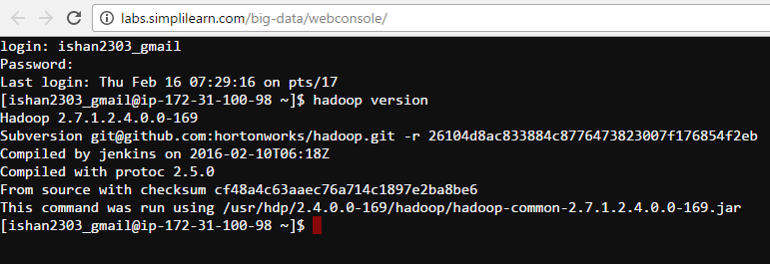
Hadoop Architecture
Hadoop 2.7
Apache spark

Slide 6
Techniques used
From Lesson 03 to load dataset into HDFS
From Lesson 11 on Spark
From Lesson 16 to work with Spark SQL
From Lesson 07 on working with Hive.
Project on realized on Hadoop cloudlab architechture.
Bigdata and Hadoop Developer Batch
6_jan_16-17-18-19-20-23-24-25-26-30-31_feb-1_2017

Slide 7
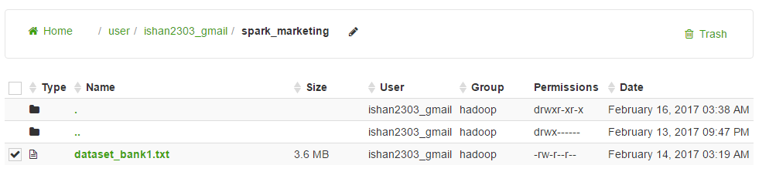
Upload dataset to HDFS
Dataset uploaded using Hue file browser.
Data cleaning was done before and the file was converted from (.csv )to (.txt) using simple Replace “ ; “ with “ , ”command in notepad.

Slide 8
Processing of data in Spark
Load Data.
val input = sc.textFile("spark_marketing/dataset_bank1.txt")
2. Create schema for data.
case class bank(age:Int, job:String, marital:String, education:String, default:String, balance:Int, housing:String, loan:String, contact:String, day:Int, month:String, duration:Int, campaign:Int, pdays:Int, previous:Int, poutcome:String, y:String)
3. Split data based on ",“
val input_split = input.map(x => x.split(","))
4. Convert RDD[Array[String]] to RDD[bank]
val bankrdd = input_split.map(e => bank(e(0).toInt, e(1), e(2), e(3),e(4),e(5).toInt,e(6),e(7),e(8),e(9).toInt,e(10),e(11).toInt,e(12).toInt,e(13).toInt,e(14).toInt,e(15),e(16)))

Slide 9
Create Dataframe.
val bankDF = bankrdd.toDF()
6. Show content of dataframe.
BankDF.show()
7.. Check Schema of DF.
bankDF.printSchema()
8. Register DF as Temp Table.
bankDF.registerTempTable("bank123")
9. Sample test query on temp table.
val result = sqlContext.sql("select * from bank123 where job = 'technician'")

Slide 10
DATA ANALYSIS

Slide 11
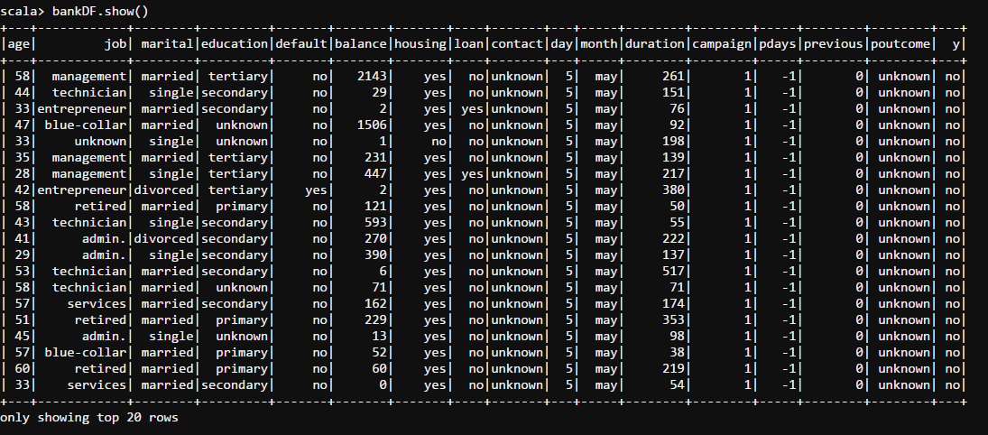
1. Load data and create Spark data frame.
Command:
val bankDF = bankrdd.toDF()
bankDF.show()
bankDF.printSchema()

Slide 12
2. (a) Marketing success rate. (No. of people subscribed / total no. of entries)
Command:
val yes = sqlContext.sql("select COUNT(y) from bank123 where y = 'yes'").collect()
val total = sqlContext.sql("select COUNT(y) from bank123").collect()
People subscribed for term deposit = 5289
Total people = 45211
Market Success Rate = (No of people subscribed /Total subscribed)*100
=(5289/45211)*100
Answer: 11.69 %

Slide 13
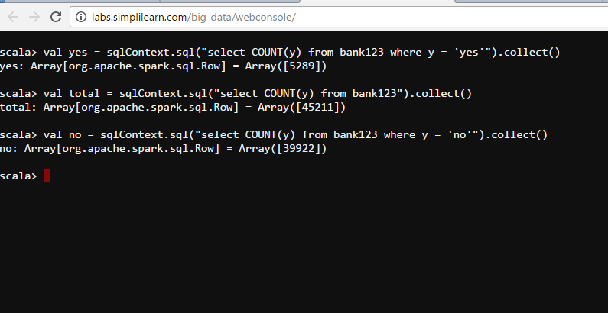
Query execution

Slide 14
2. (b) Give marketing failure rate
Command:
val no = sqlContext.sql("select COUNT(y) from bank123 where y = 'no'").collect()
No of people not subscribed = 39922
Market Failure Rate = (No of people NOT subscribed /Total subscribed)*100
= (39922/45211)*100
Answer: 88.30%

Slide 15
3. Maximum, Mean, and Minimum age of average targeted customer.
Command:
val max = sqlContext.sql("select MAX(age) from bank123").collect()
val min = sqlContext.sql("select MIN(age) from bank123").collect()
val avg = sqlContext.sql("select AVG(age) from bank123").collect()
Answer:
Max age = 95
Min age = 18
Mean age = 40.93

Slide 16
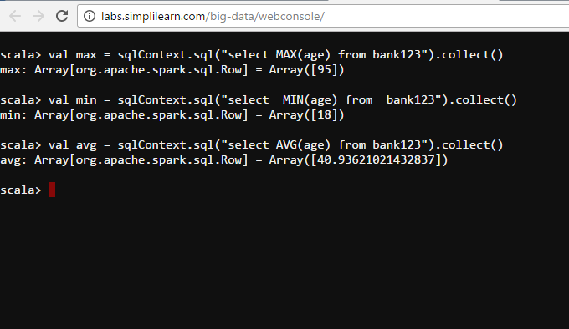

Slide 17
4. (a) Check quality of customers by checking average balance, median balance of customers
Command:
val avg_bal = sqlContext.sql("select AVG(balance) from bank123")
Answer:
Average balance = 1362.27
(continued)

Slide 18
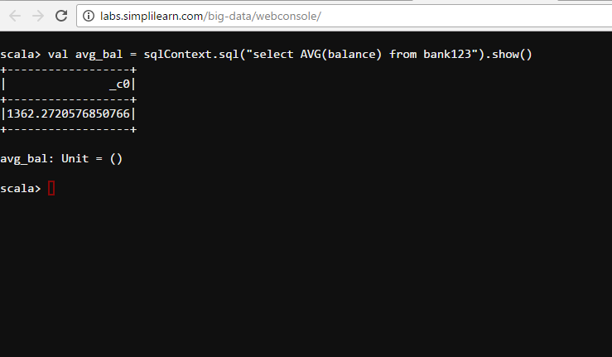

Slide 19
4. (b) Calculate median balance
Commmand :
val balance= sqlContext.sql("select balance from bank123 order by balance asc").collect()
var balancearray= balance.map(_.getInt(0)).map(_.asInstanceOf[Double])
def median(s: Array[Double]) ={
val (lower, upper) = s.sortWith(_<_).splitAt(s.size / 2)
if (s.size % 2 == 0) (lower.last + upper.head) / 2.0 else upper.head}
median(balancearray)
Answer:
Median Balance = 448.0

Slide 20
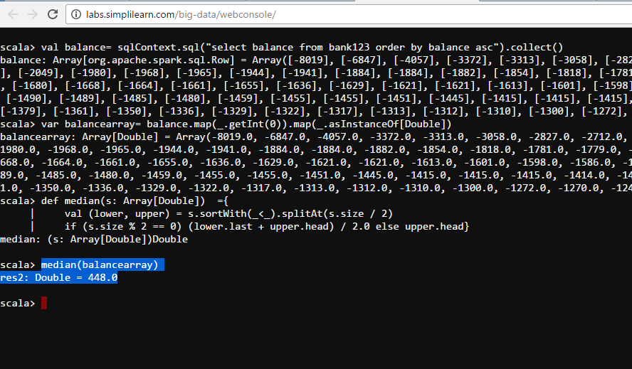

Slide 21
5. Check if age matters in marketing subscription for deposit
Command:
val age_v = sqlContext.sql("select distinct(age) from bank123 where y = 'yes'").collect()
Answer: After analyzing the result, it can be concluded that the minimum age for subscription to term deposit is 18 years.

Slide 22
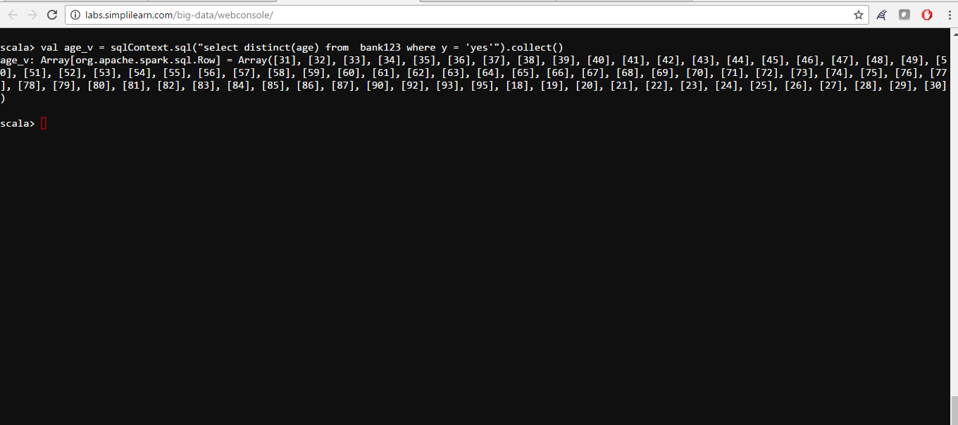

Slide 23
6. Check if marital status mattered for subscription to deposit.
Command:
val marital = sqlContext.sql("select distinct(marital) from bank123 where y = 'yes'").collect()
Answer: The marital status does not matter for subscription to deposit. Because, All 3 distinct marital status ie. Single, Married and Divorced are displayed.

Slide 24
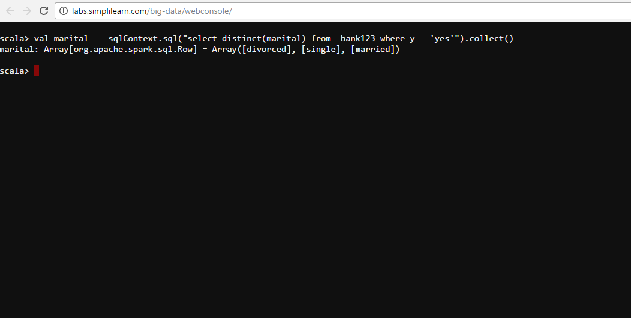

Slide 25
7. Check if age and marital status together mattered for subscription to deposit scheme
Command:
val marital_age = sqlContext.sql("select distinct age,marital,y from bank123 where y = 'yes'").show()
val marital_age = sqlContext.sql("select distinct age,marital,y from bank123 where y = 'no'").show()
Answer: age and marital status together do not matter for subscription to deposit.

Slide 26
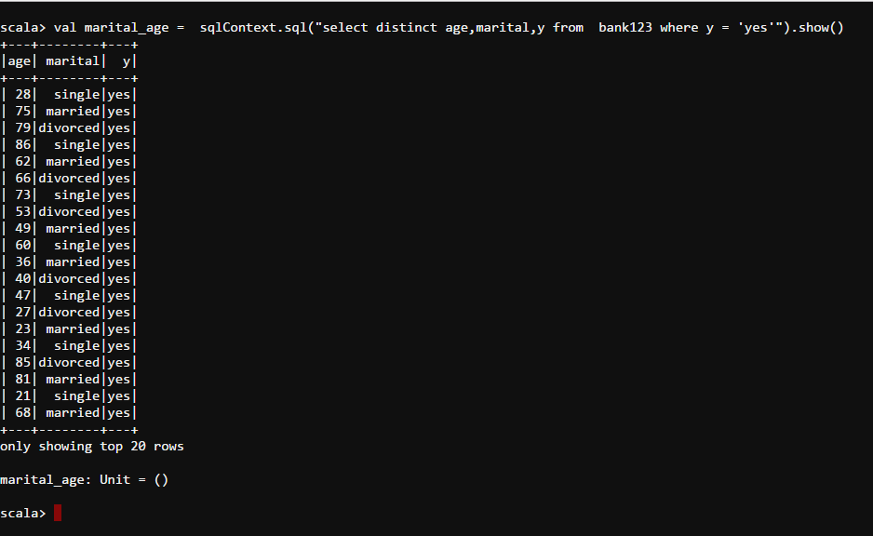

Slide 27
8. Do feature engineering for column—age and find right age effect on campaign
Command:
val feature_first = bankDF.sort($"campaign".desc).select("campaign","age").first()
val feature = bankDF.sort($"campaign".desc).select("campaign","age").show()
Answer: Feature engineering can be analyzed from the result set and the output screenshot.

Slide 28
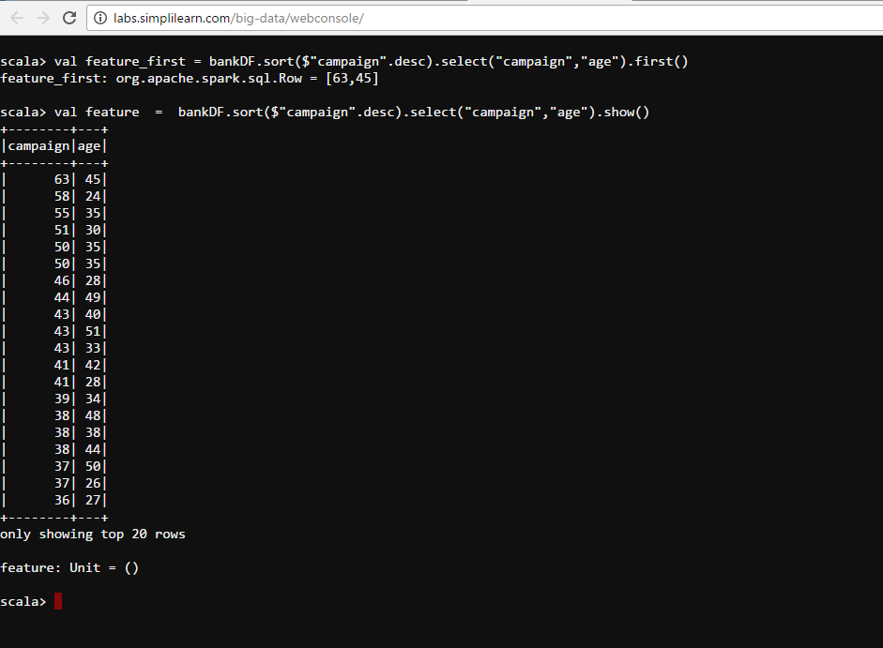

Slide 29
Thank You

